Slide 1


第六章
第六章
第一步：下载数据
第二步：上传数据
Run the code on the server
Guoqin Mai

Slide 2
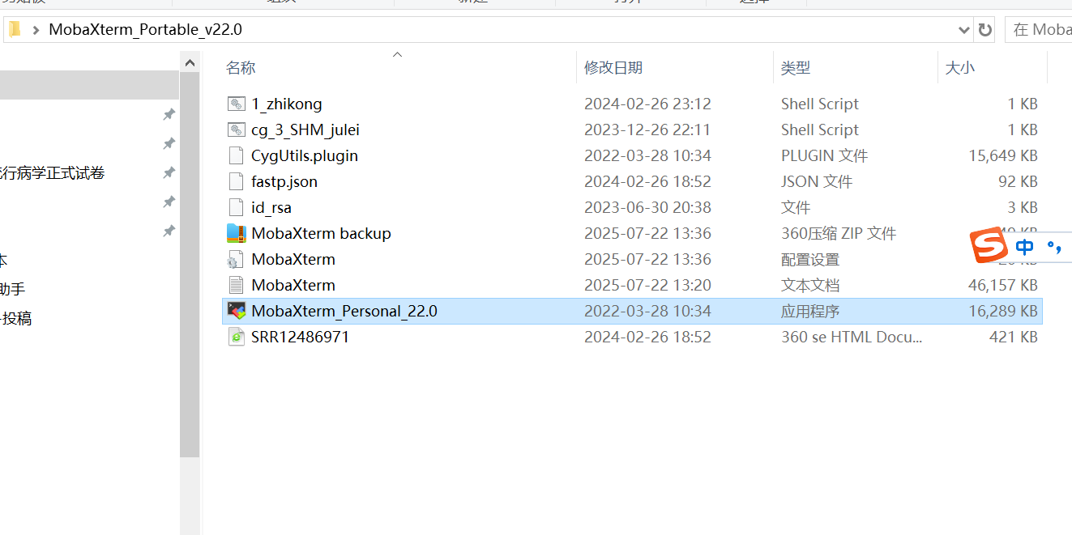
1、Double click the mouse to open the software MobaXterm_Personal_22.0
。

Slide 3
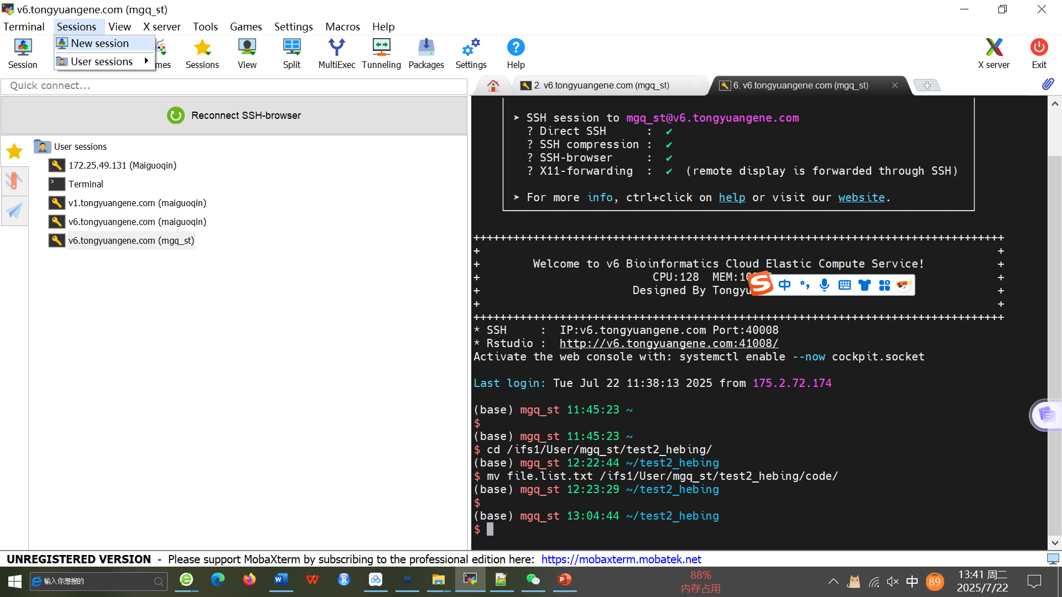
2、Log in the account on the software MobaXterm_Personal_22.0

Slide 4
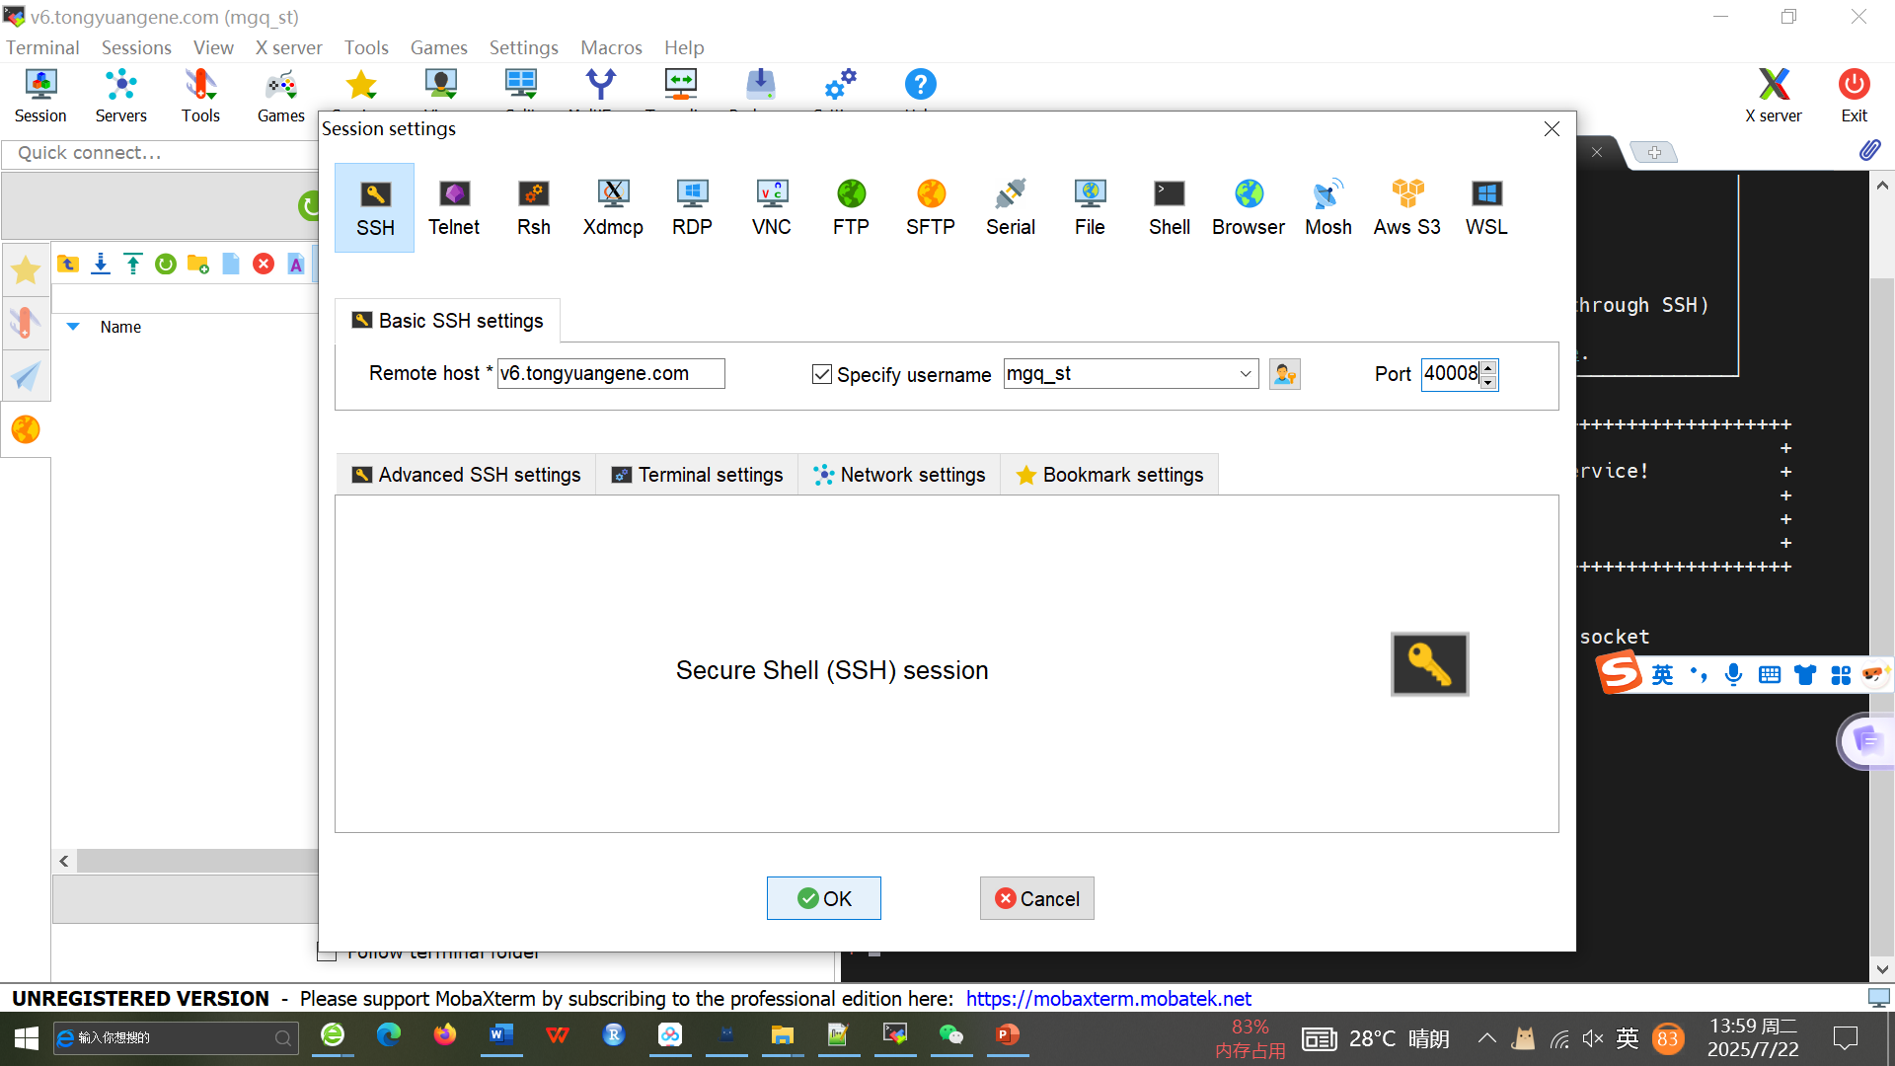
3、Fill in the IP, port and username on the software Mobaxterm_personal_22.0, and click
IP：
Port ：
username：
Password：

Slide 5
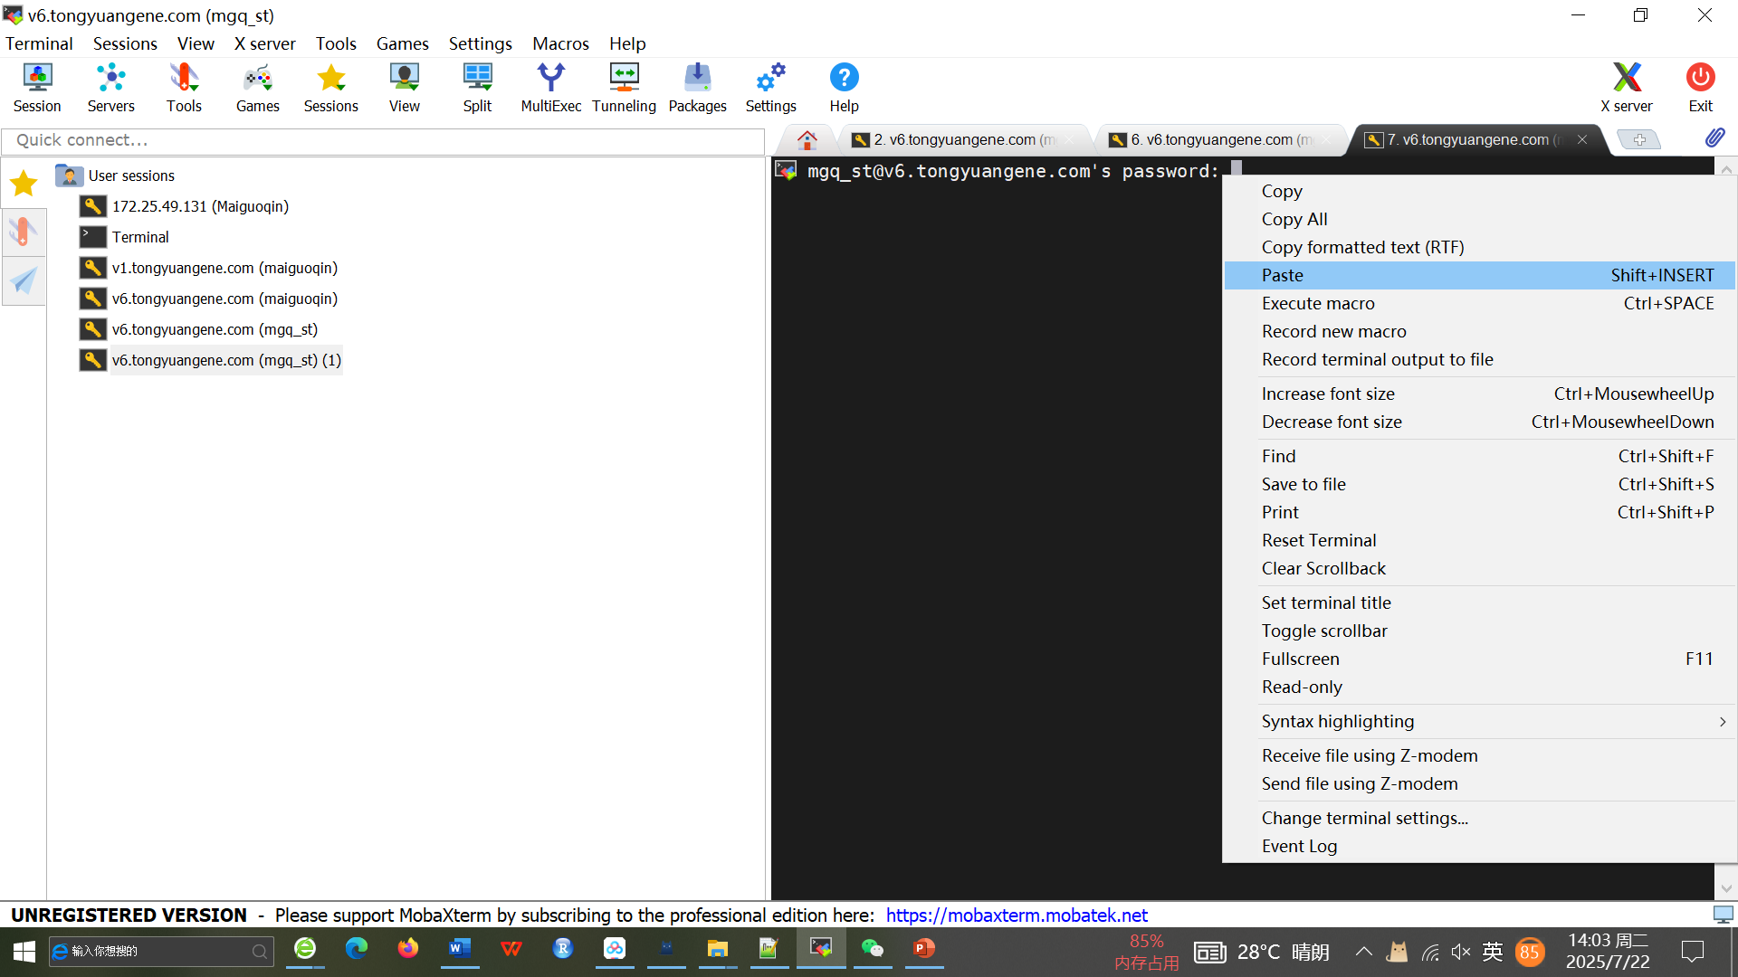
4、Write the password on the software mobaxterm_personal_22.0,
that is, copy the password, right-click and paste
IP：
Port ：
username：
Password：

Slide 6
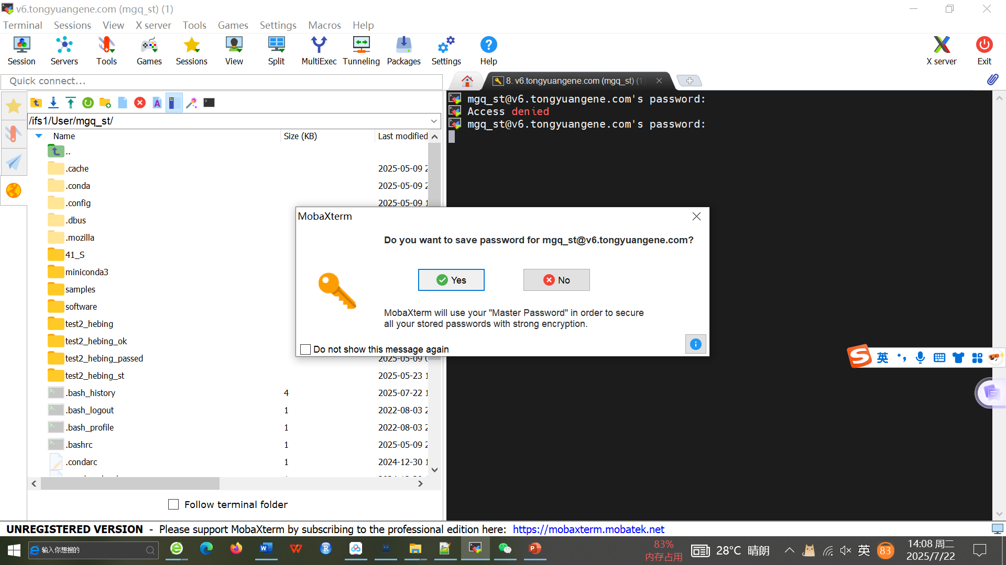
5、Copy the password, and click Yes

Slide 7
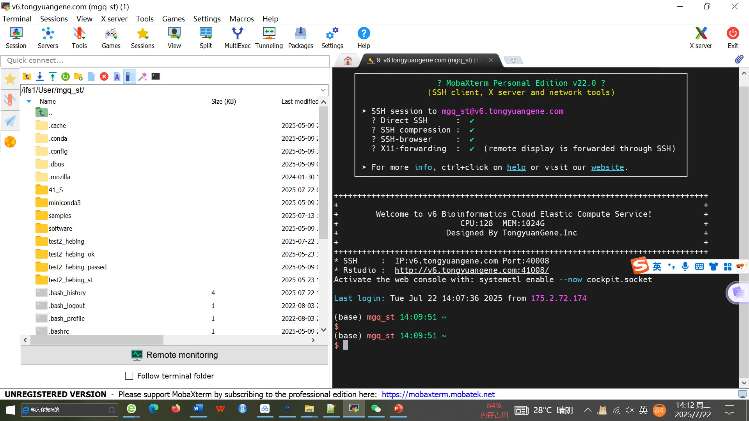
6、Login succeeded

Slide 8
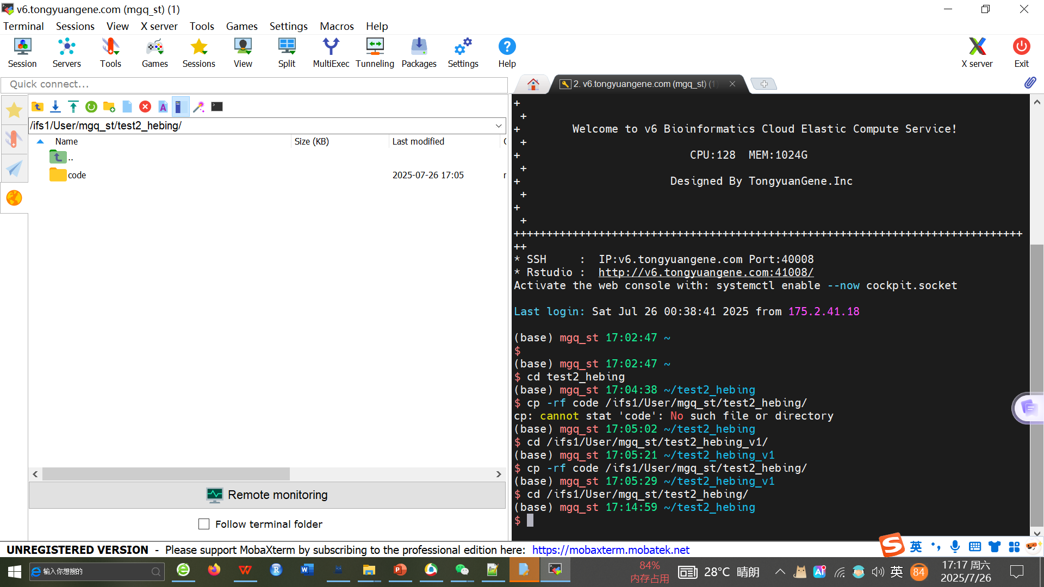
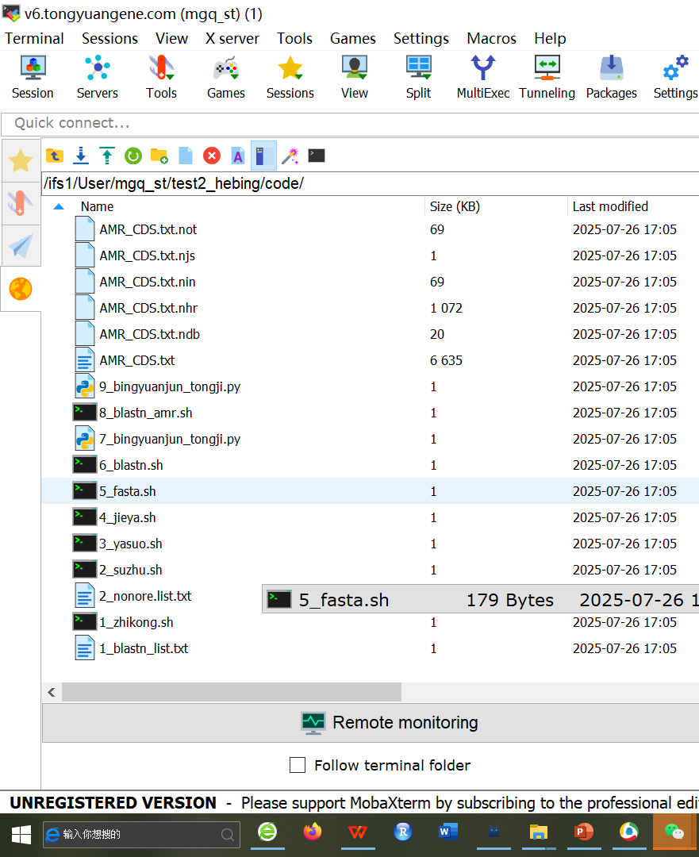
8、Go to the file directory and view: cd /ifs1/User/mgq_st/test2_hebing/

Slide 9
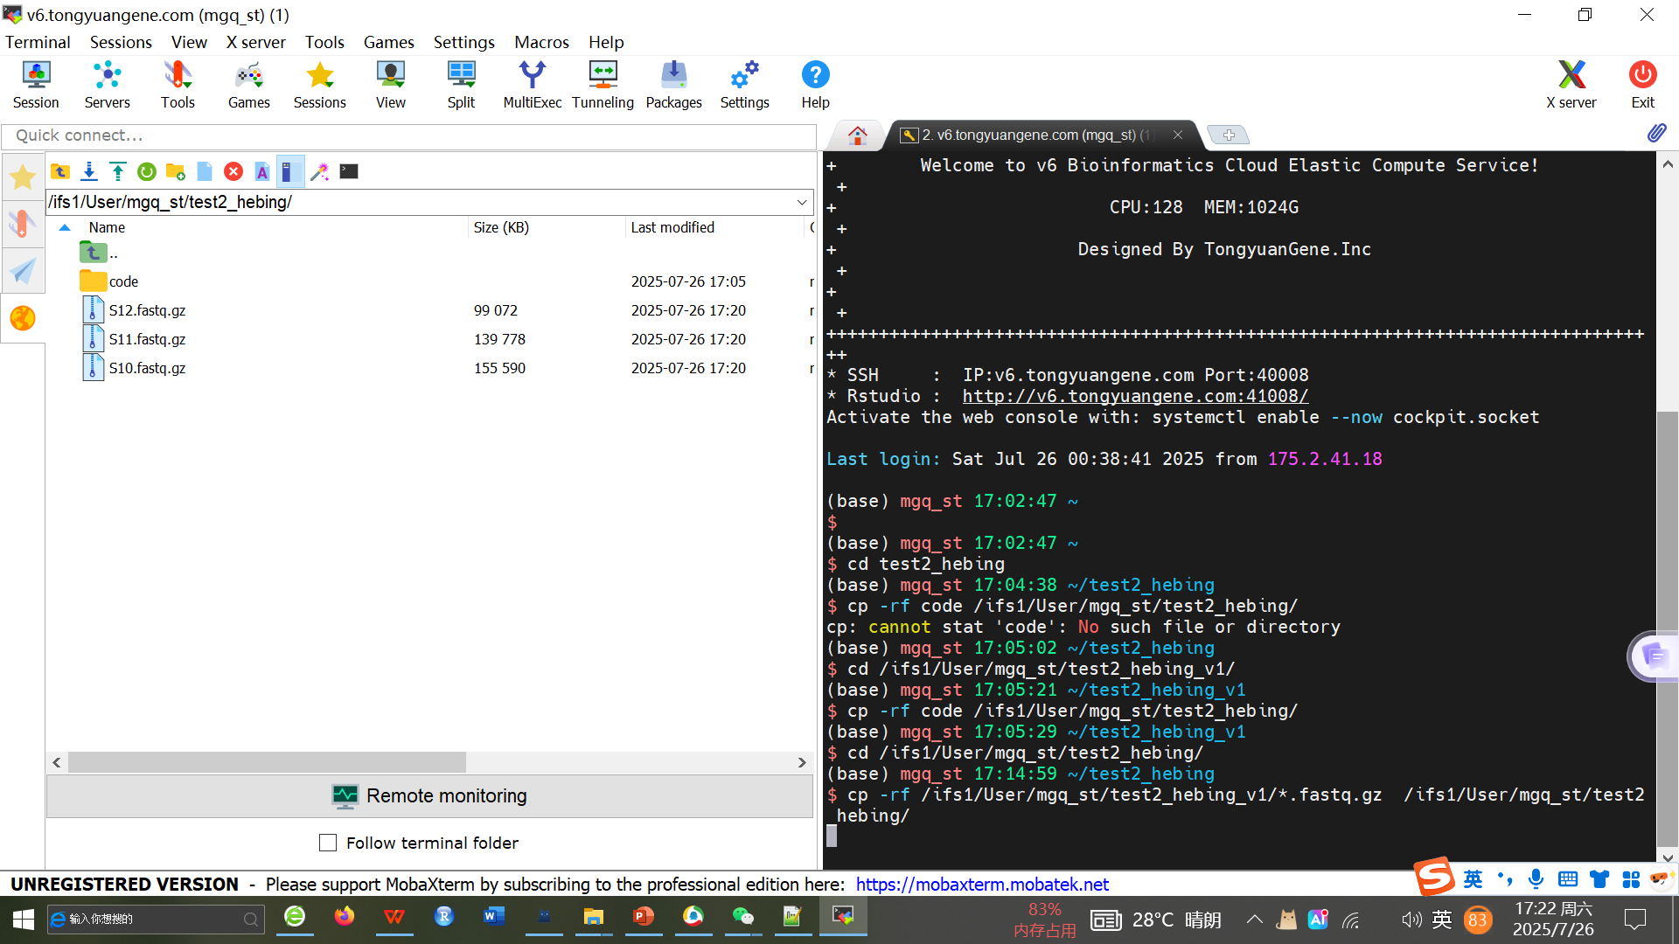
9、Copy the files to be run to the file directory.
That is, after copying and pasting the code, press enter.
Code：cp -rf /ifs1/User/mgq_st/test2_hebing_v1/*.fastq.gz /ifs1/User/mgq_st/test2_hebing/

Slide 10
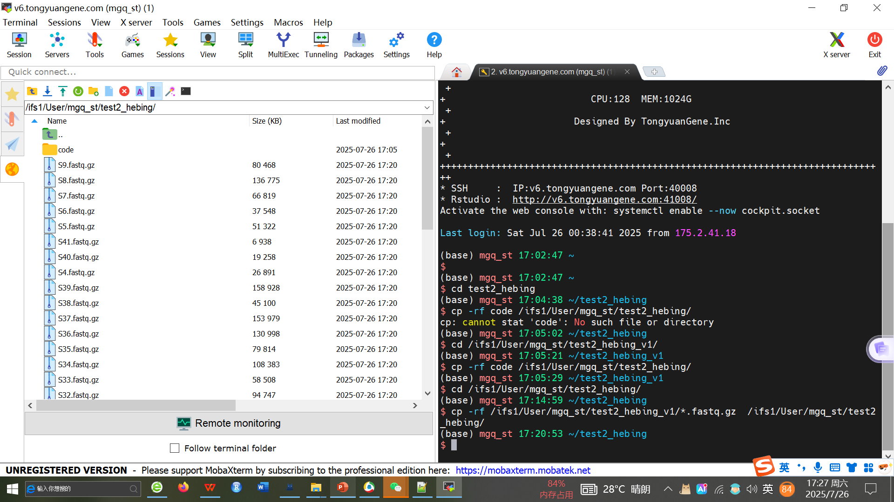
9、Copy the files to be run to the file directory,
That is, after copying and pasting the code, press enter. The effect is as follows:
Code：cp -rf /ifs1/User/mgq_st/test2_hebing_v1/*.fastq.gz /ifs1/User/mgq_st/test2_hebing/

Slide 11
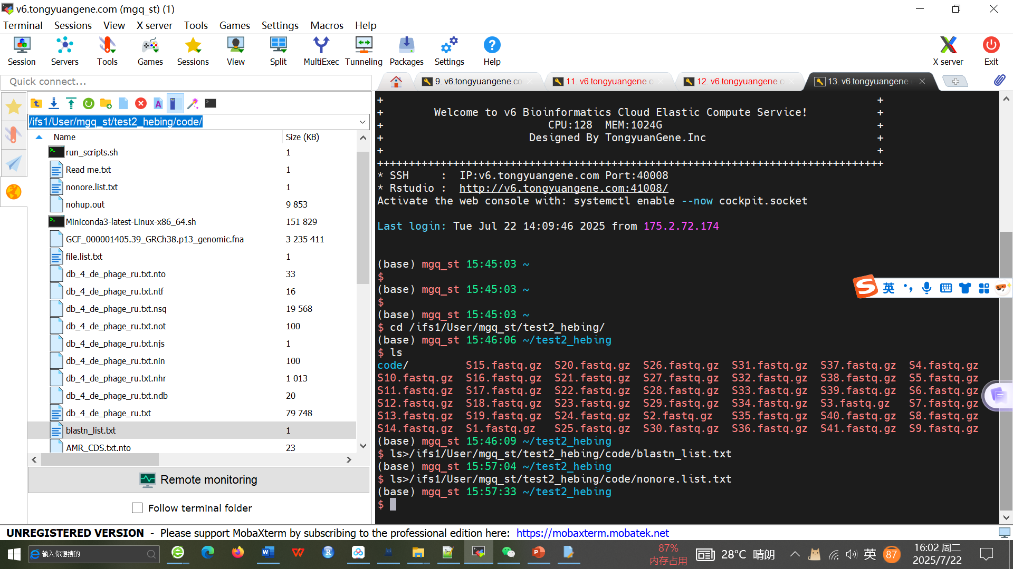
10、Create 2 sample name lists
Code： ls *.gz>/ifs1/User/mgq_st/test2_hebing/code/blastn_list.txt
ls *.gz>/ifs1/User/mgq_st/test2_hebing/code/nonore.list.txt

Slide 12
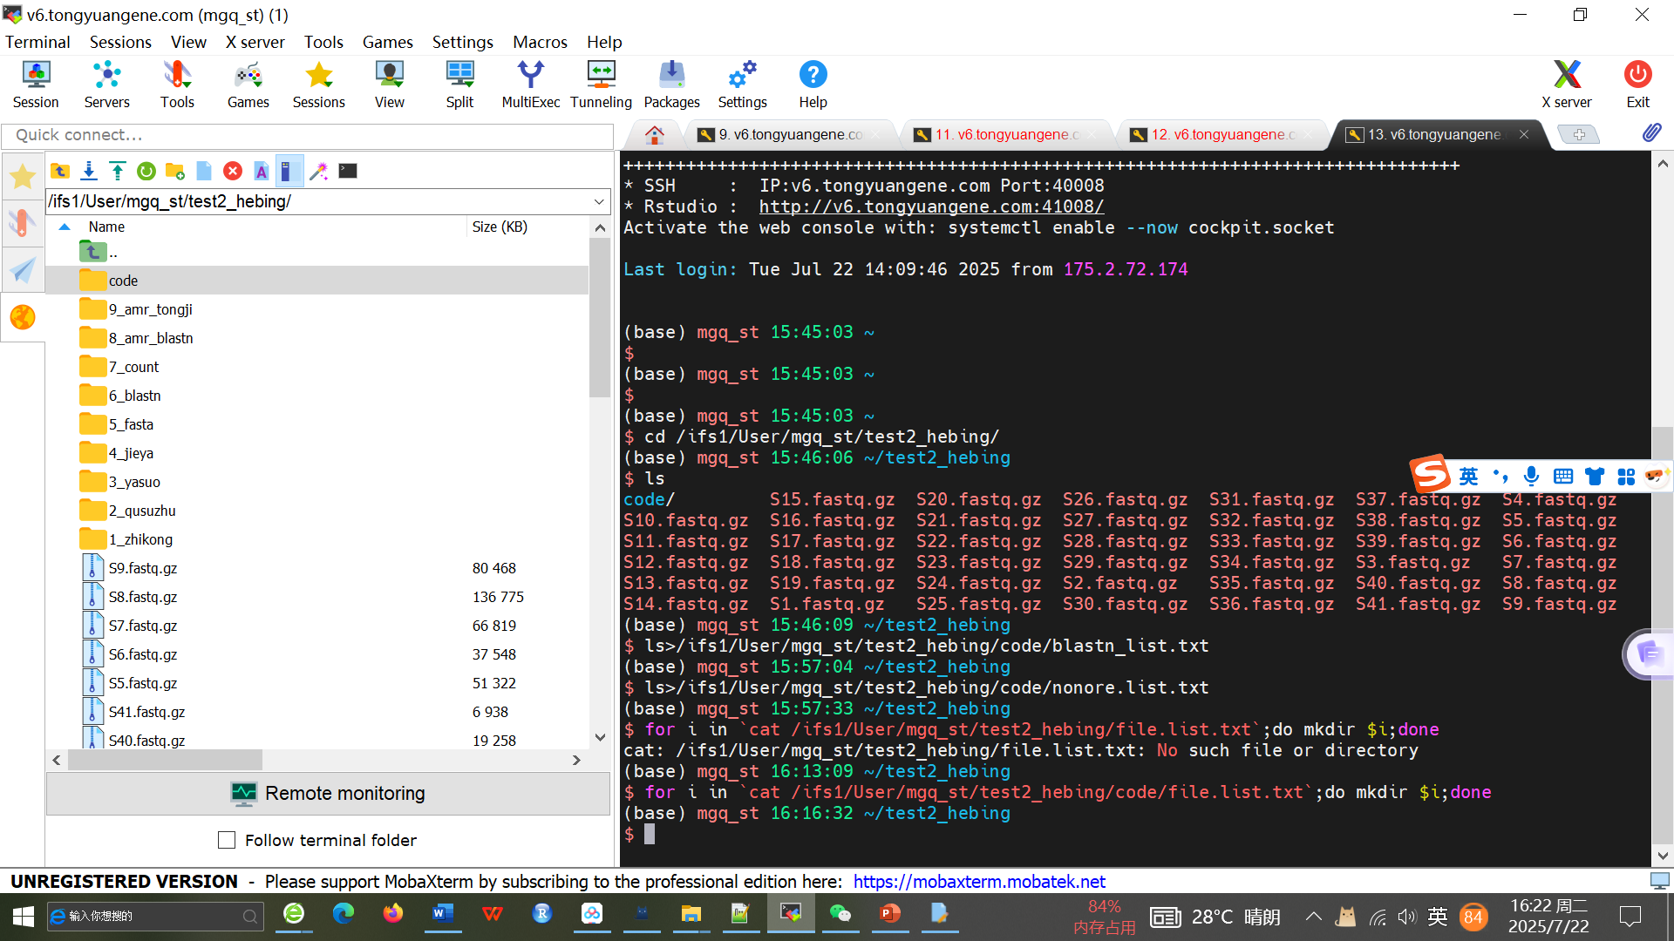
11、Create the output folder in batch with the following code:
Code： for i in `cat /ifs1/User/mgq_st/test2_hebing/code/file.list.txt`;do mkdir $i;done

Slide 13
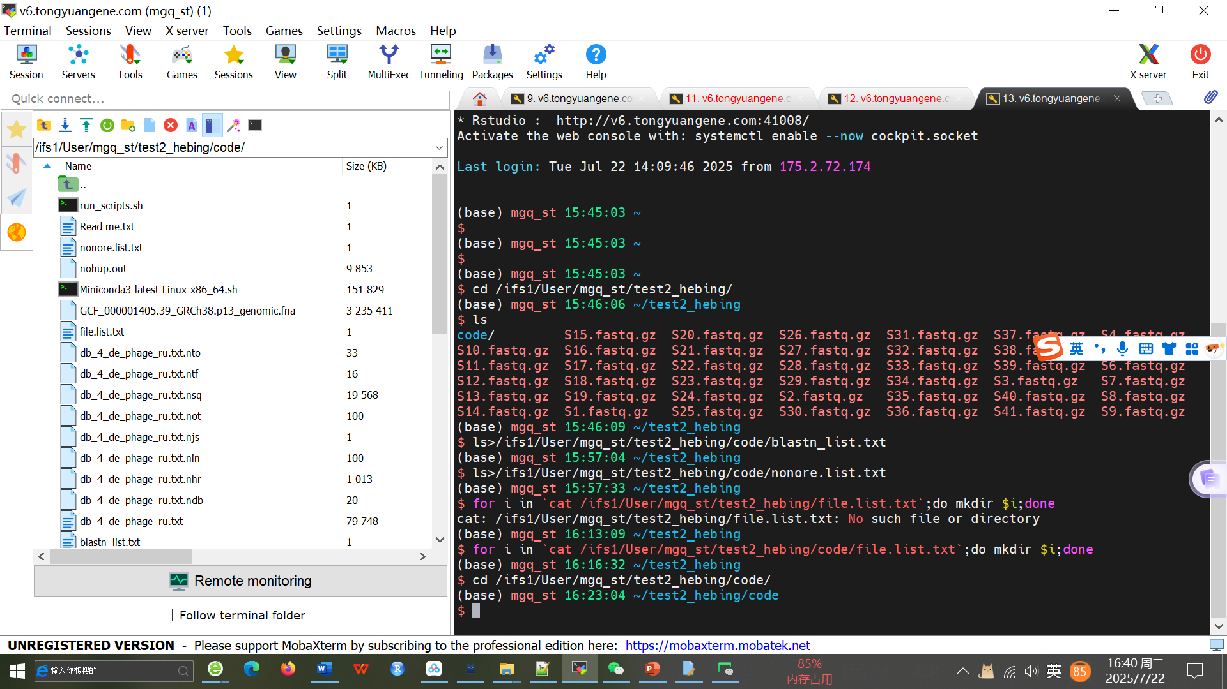
12、Go to the running directory, and the code is as follows:
Code： cd /ifs1/User/mgq_st/test2_hebing/code/

Slide 14
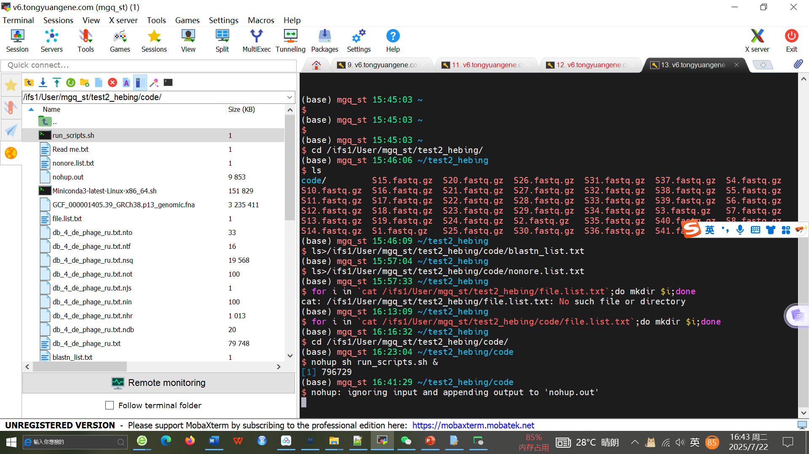
13、Run the code as follows:
Code： nohup sh run_scripts.sh &

Slide 15
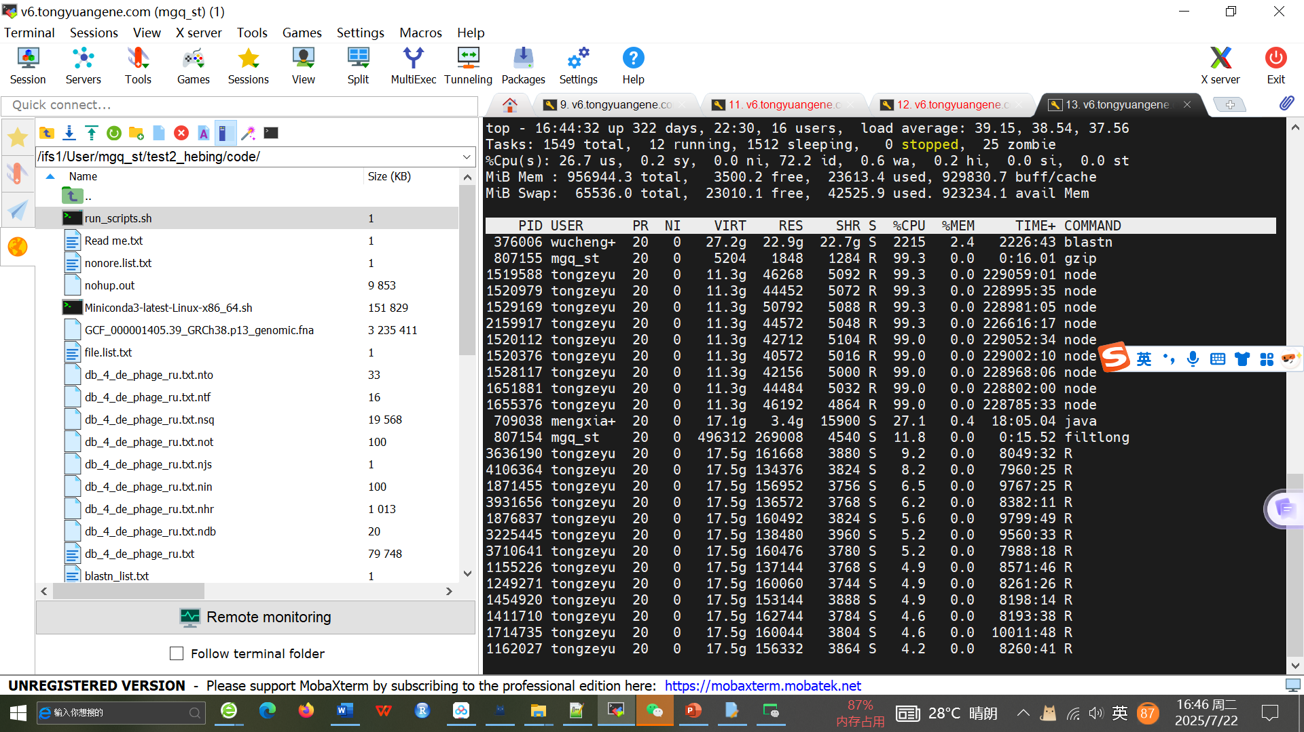
14、To view the status of code running:
Code： top

Slide 16
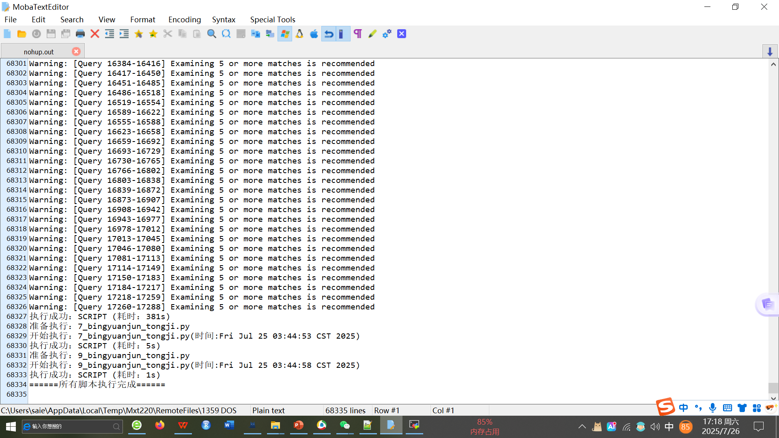
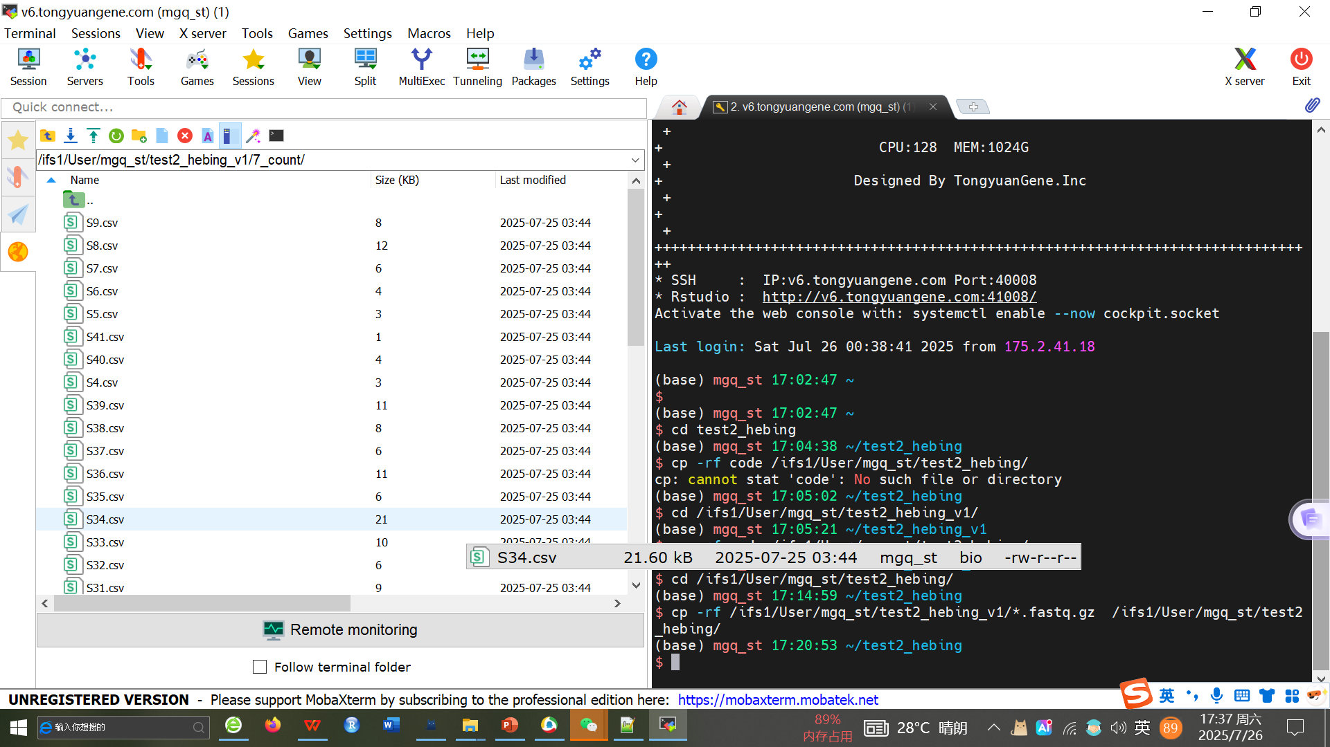
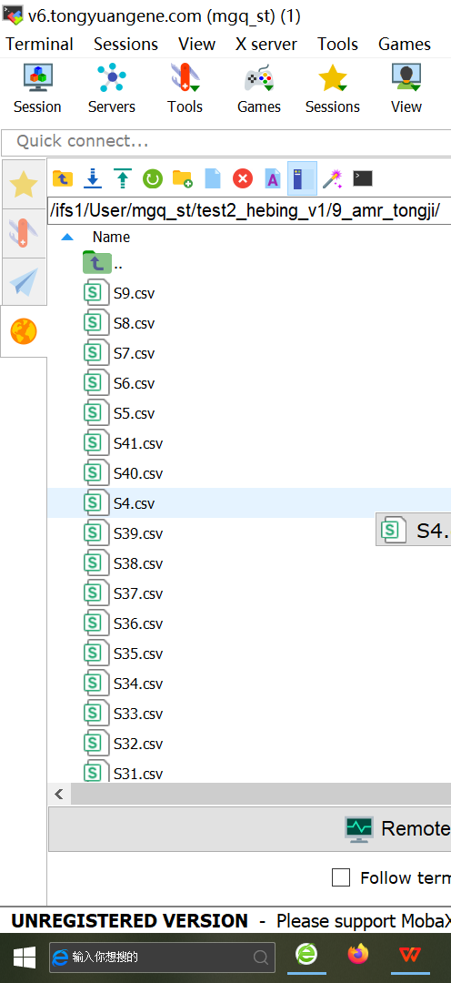
15、View the log of code running results: select nohup.out, right-click to open

